Slide 1



NOAA Algorithm Scientific Software Integration and System Transition Team (ASSISTT) Collaboration with CSPP Geo on L2 Product Software
Hua Xie^{1,3}, Shanna Sampson^{2,3}, Tom King^{1,3},
Yunhui Zhao^{2,3}, Claire McCaskill^{1,3}, Ricky Rollins^{2,3},
Aiwu Li^{1,3}, Brian Helgans^{2,3} and Walter Wolf³
¹I. M. Systems Group, Rockville, MD 20852, USA
²GAMA-1 Technologies, Greenbelt, MD 20770, USA
³NOAA/NESDIS/STAR, College Park, MD 20740, USA

Slide 2
Outline
Introduction to Algorithm Scientific Software Integration and System Transition Team
Collaboration with CSPP
  Current work
  Future plan
Summary

Slide 3
What is ASSISTT?
ASSISTT (40+ personnel)
Lead: Walter Wolf
Process Lifecycle and Algorithm Integration Team
Lead: Tom King
Technology, Testing, and Transition Team
Lead: Shanna Sampson
Delivery Algorithm Package delivery
Algorithm Implementation
Near Real Time Processing
Framework Development
Special Data Request
Quality Assurance
Configuration Management
Regression Testing
Documentation (SMM, EUM, ADD etc.)
FORTRAN /C++
PYTHON/PERL

Slide 4
ASSISTT’s role
Research | ASSISTT | Operation
New
Alg.
Integration
Preliminary
DAP
Updated
Test Readiness Review
Alg. Development
Integration Validation
Software Review
Operation
Critical Design Review
Mimic Operation
Alg. Readiness Review
Official
DAP
Alg.
Validation

Slide 5


ASSISTT’s role
NOAA OSPO
Clouds
GPO
NOAA NDE
Aerosols
GOES-R Ground
NOAA NWS
Lands
Operation
Science teams
ASSISTT
CSPP
Winds
NOAA contractors
NASA Fire Project
Aviation
NOAA Cloud Pilot Team
Hydrology
Naval Research Lab
Cryosphere

Slide 6
Current collaboration
Bi-weekly 1-hr telecon with CSPP for Geo
  ASSISTT: summary including STAR Algorithm Processing Framework development, algorithm implementation status, delivery schedule, etc.
  CSPP: progress and updates
  Interaction: detailed technical questions

Slide 7
Current collaboration
Deliveries to CSPP
  SAPF source code in git
  DAP deliveries on CSPP’s machine
    Source code
    Testing dataset
    Documentations
CSPP-Geo AIT testing on ASSISTT’s side
  Regular Linux
  Docker container in Cluster

Slide 8
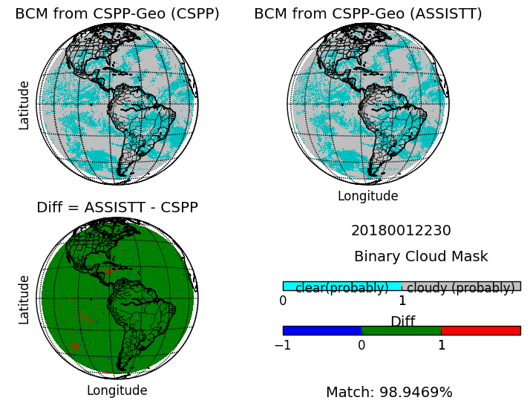
CSPP-Geo AIT testing
(cspp-geo-aitf-1.0.27beta)

Slide 9
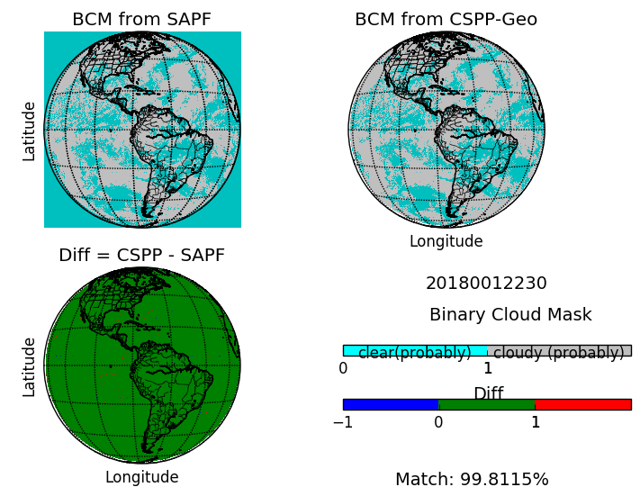
Framework vs. CSPP-Geo AIT
Comparison

Slide 10
Comparison
ASSISTT generated Baseline Cloud Mask with CSPP-geo beta package on both regular Linux and Docker container in Cluster
Slight difference between CSPP team and ASSISTT can be explained by uncertainties in environment setup
ASSISTT also generated BCM with Framework (FW) and compared; good agreement indicates BCM is processed well as expected in CSPP-geo

Slide 11
Future plan
ASSISTT is transitioning from FW1 to FW2
ASSISTT is going to collect enterprise version scientific updates from teams and deliver those updates in FW2 to GOES-R Ground for GOES-17 maturity review
ASSISTT will deliver enterprise version algorithms in FW2 to CSPP

Slide 12
Cloud Mask update
GOES-R Cloud Mask team :
  Andy Heidinger (lead), William Straka,
  Denis Botambekov, and Yue Li
Baseline (BL):
  Delivered to GOES-R GPO in 2011 by ASSISTT, need Temporal (previous 1-hr Cloud Mask and previous 1 time step CRTM)
Enterprise (EN):
  Naïve Bayesian method with more sensor channels and new tests, no Temporal needed

Slide 13
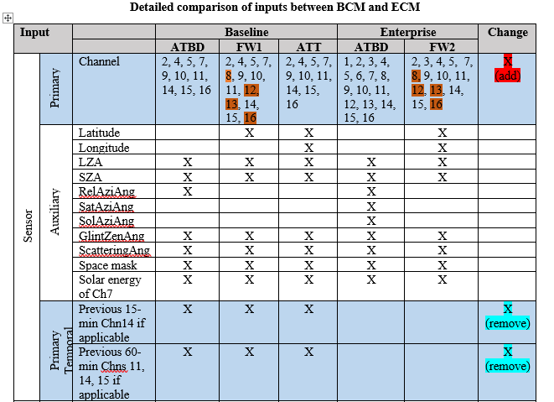
Cloud Mask update

Slide 14
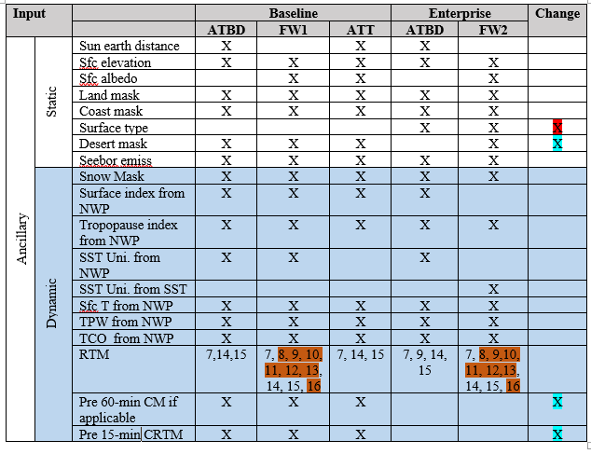
Cloud Mask update

Slide 15
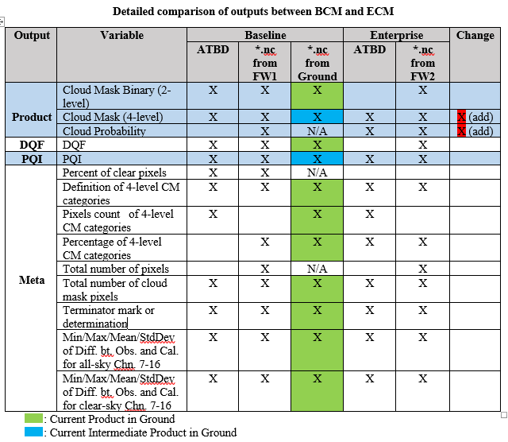
Cloud Mask update

Slide 16
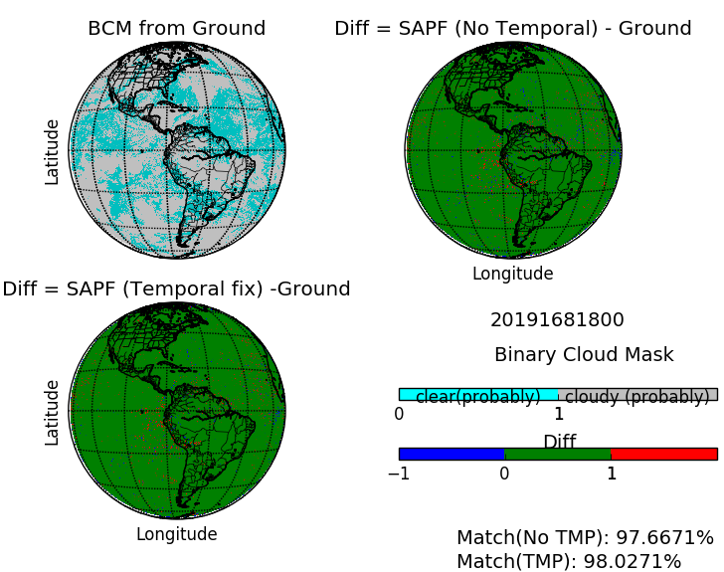
Cloud Mask comparison
Mode 6
New GFS data gv3

Slide 17
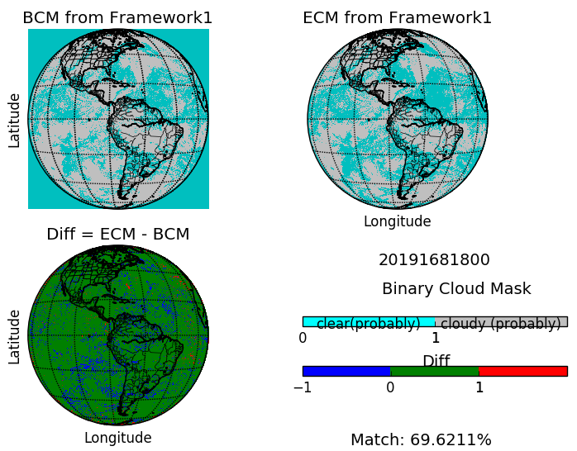
Cloud Mask comparison
Less cloud from ECM

Slide 18
Comparison
Selecting cloud mask algorithm as an example, it is obviously seen that outputs change due to the development of the algorithm by the science team
We're expecting enterprise algorithms to perform better than their baseline counterparts which will improve product results in CSPP-Geo
  Development of algorithm itself
  Development of upstream algorithms

Slide 19
Framework comparison
 | Framework1 (FW1) | Framework2 (FW2)
Developing time | 2007 | 2017
Compiler requirement | Intel 11+ GNU 4.4.3+ | Intel 16.0.4 + GNU 5.4.0 + Python3 +
Programming language | FORTRAN 90 C++ | FORTRAN 2003 C++ 11 standard
Run configuration | X | X
Sequential processing | X | X
Parallel processing |  | X
Data cache |  | X
Padding |  | X
Algorithm | BL + EN | EN

Slide 20
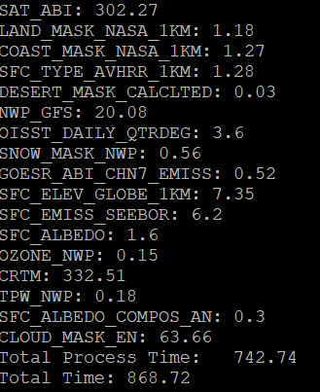
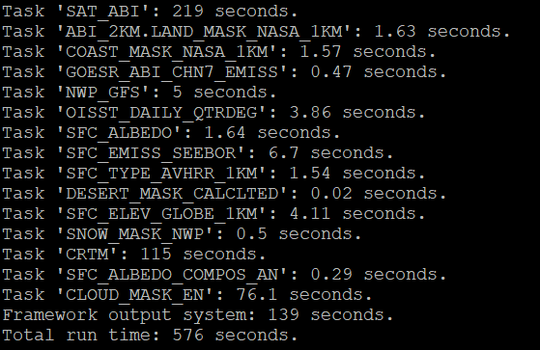
FW running time comparison
(sequential)
FW1
FW2
~15-min
~10-min

Slide 21
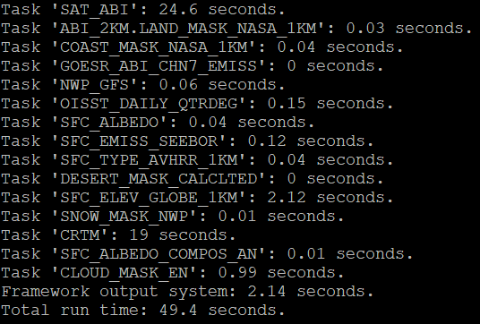
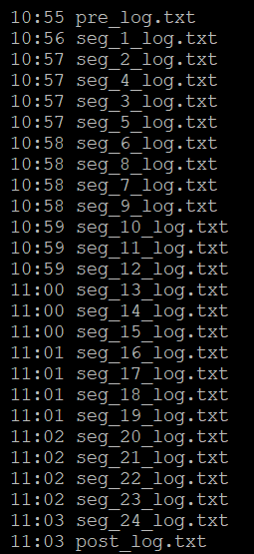
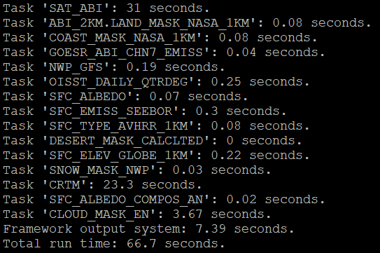
FW2 running time sample
(parallel)
  Segments: 24
  Max jobs: 4
Seg1
Seg11
~8-min

Slide 22
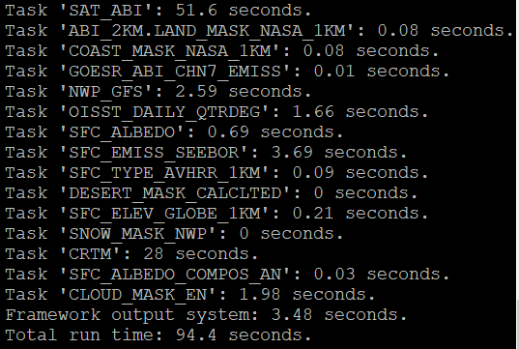
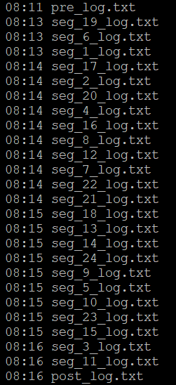
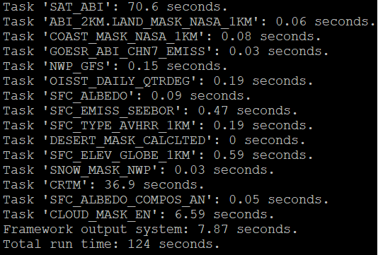
FW2 running time sample
(parallel)
  Segments: 24
  Max jobs: 24
Seg1
Seg11
~5-min

Slide 23
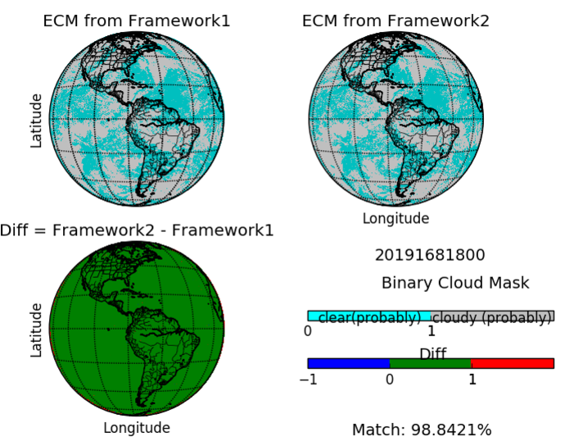
Framework comparison
(padding)

Slide 24
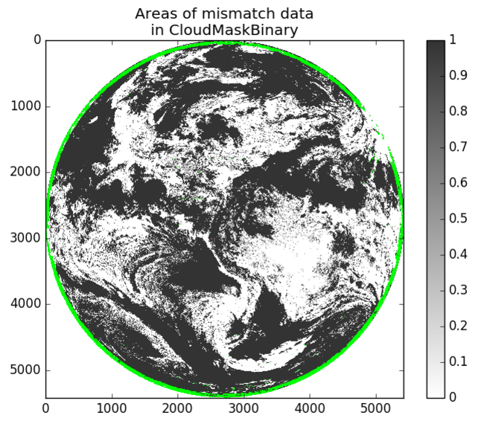
Framework comparison
Differences in boundary
Glance
https://gitlab.ssec.wisc.edu/evas/UW-Glance/wikis/home

Slide 25
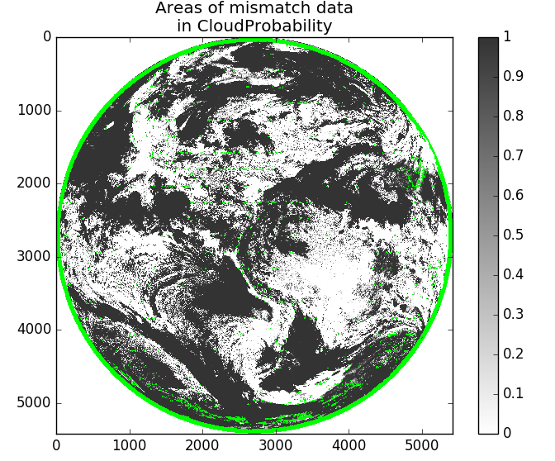
Framework comparison

Slide 26
Summary
BL Cloud Mask in CSPP-Geo performs well
ASSISTT is making steady progress in Framework development and maintenance
ASSISTT is preparing for EN version algorithms delivery for GOES-17 maturity review
EN algorithms are expected to perform better than BL counterparts which will also improve products in CSPP-Geo
ASSISTT will start to deliver EN version algorithms in Framework version 2 to GOES-R Ground and CSPP this fall

Slide 27
Thank you !

